Slide 1
From SOA to MSA– Creating Adaptive and Innovation Supportive Architecture and Organization
-by William

Slide 2
Topics
Principles of Microservices Architecture
Patterns and Best Practices of Microservices
Microservices Organization
Application of Microserivces Architecture

Slide 3
Problem Domain
System & Organization Decoupling
Legacy System Upgrading
Use suitable platform and technology to solve different problems
Golden Hammer Syndrome - Always Win/.Net
Foster business innovation, dealing with outside competition
Innovation as a platform
Creating extensible, agile and adaptive architecture and organization.

Slide 4
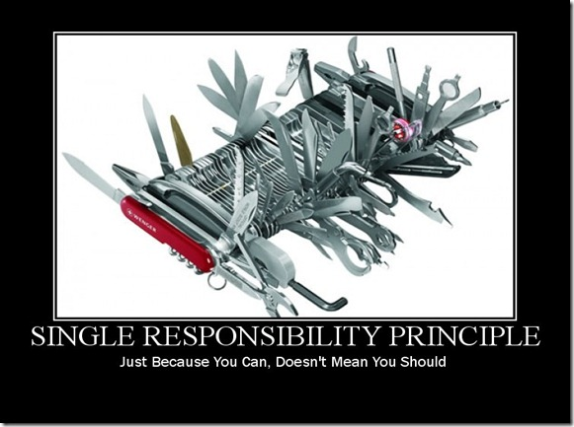
SOLID Review - Single Responsibility Principle

Slide 5

SOLID Review – Liskov Substitution Principle

Slide 6

SOLID Review – Dependency Inversion Principle

Slide 7
GRASP – General Responsibility Assignment Software Principles
High Cohesion, Low Coupling
How to keep objects appropriately focused, manageable and understandable?
How to minimize dependencies, change impact and maximize reuse?
Information Expert
What’s the general principle to assign responsibilities to object?
Controller
Who should receive events and coordinate the overall system operation?
Polymorphism
How to make components pluggable?
Pure Fabrication
How to assign responsibilities to class representing concept not existing in problem domain？
Indirection
How to decouple between two(or more) objects?
Protected Variation
How to design object or system that its internal instability or variation will not have bad impact to other elements of the object or system？

Slide 8
Microservices Architecture
A system architectural style, it is SOLID and GRASP principles applied at architectural level, including some patterns and best practices.
SOA is too coarse-grained, Microservices is fine-grained and practical SOA.
Microservices architecture needs technical infrastructure and organization support.

Slide 9
Monolithic -> SOA -> MicorServices

Slide 10
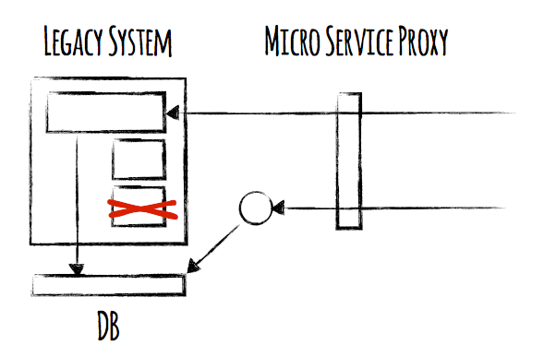
Legacy System Decouple & Upgrade

Slide 11
Coupled SOA
Coupling
Coupling
Middle Tier Svc
Edge Svc

Slide 12
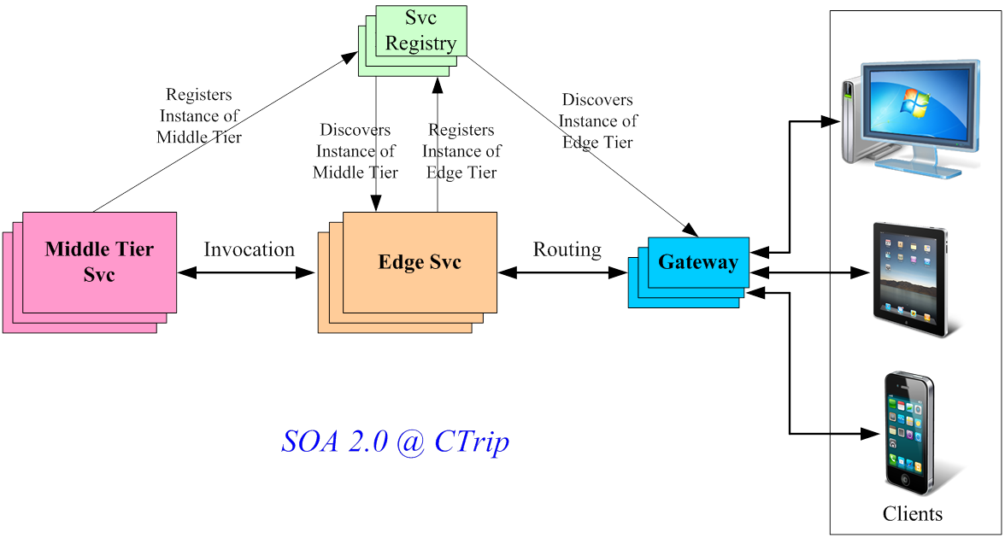
Decoupled SOA
IoC
Proxy

Slide 13
Balance Standardization & Autonomy
Autonomy
Standardization

Slide 14

Standardization
Monitoring
Interface
Deployment

Slide 15
Key Elements of Microservices Architecture
Stateless Service
Support scale out
Low Friction Deployment
Fast and flexible service deployment and upgrade.
Automated Management & Monitoring
Push common concerns to technical infrastructure and framework, service developers only need to care for business logic.
Automated Service Discovery & Routing
Decouple services, flexible upgrade and replacement.

Slide 16
Microservices Framework

Slide 17
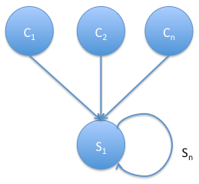
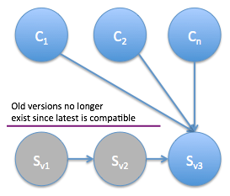
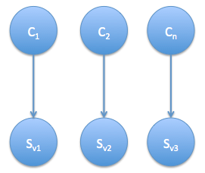
Version Control of Microservices
Leave multiple old microservice versions running
Fast introduction vs. slow retirement asymmetry
Brute force upgrade
Backward compatible
Multiple versions coexistence

Slide 18
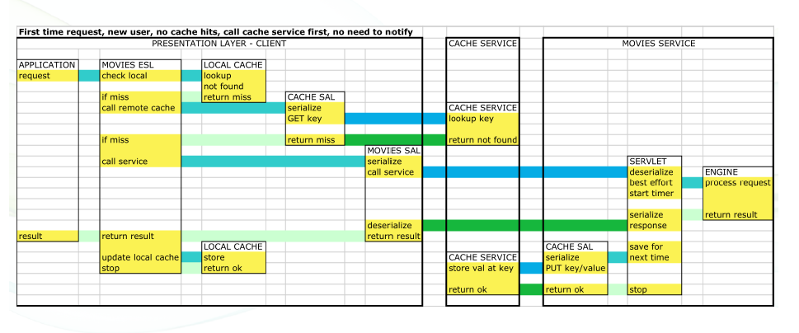
Invocation Pattern of Microservices

Slide 19
Service Dependency

Slide 20
Single Dependency Delay Causing Blocking of User Request

Slide 21
All Request Threads Can be Blocked at Peak Hour(aka. Cascading Failure)

Slide 22
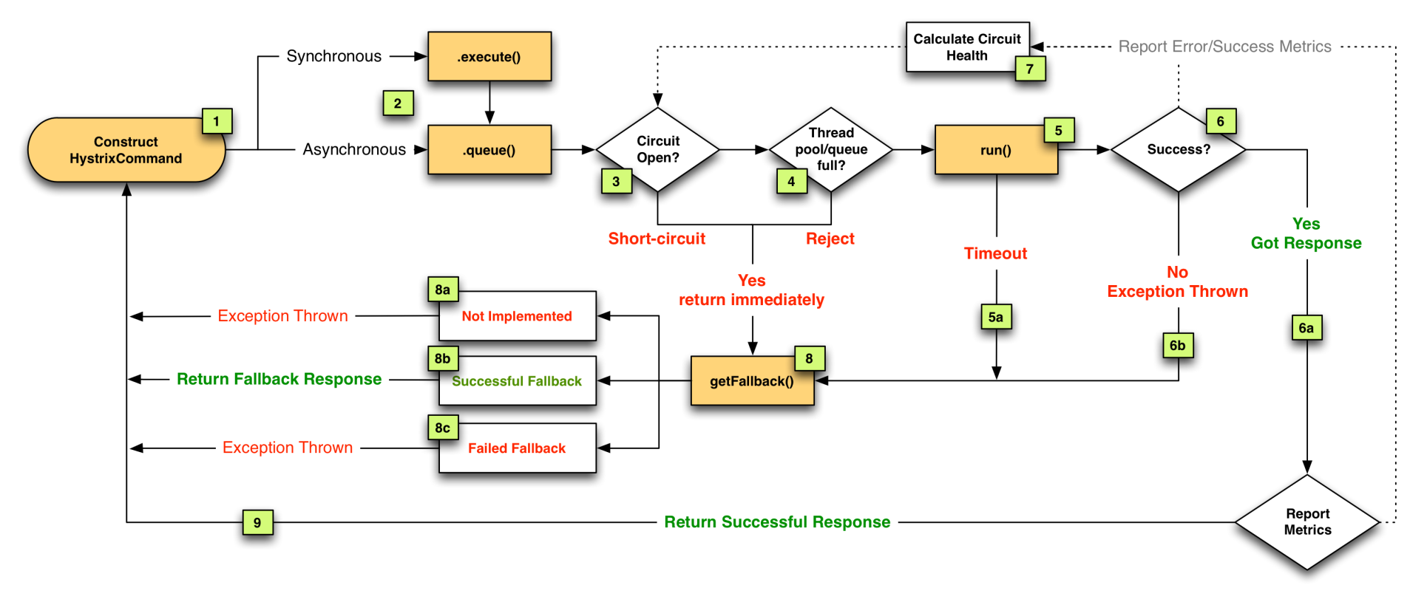
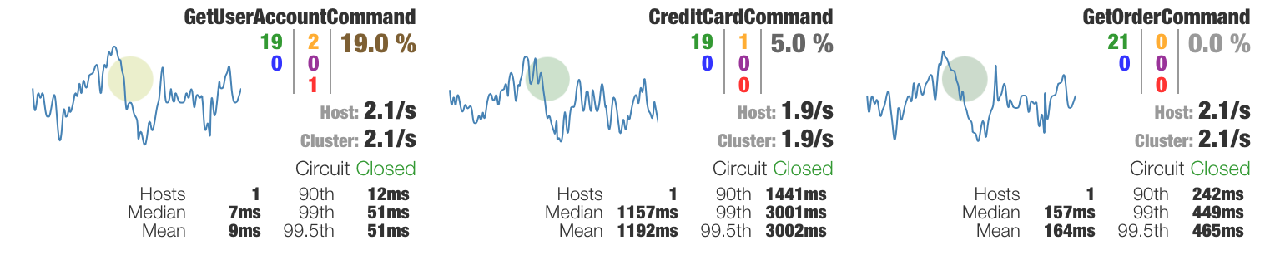
Circuit Breaker Fault Tolerant Pattern
https://github.com/Netflix/Hystrix

Slide 23
Cross Data Center Active-Active
Fallback Invocation
Fallback Invocation

Slide 24
Conway’s Law
“…organization which design systems … are constrained to produce designs which are copies of the communication structure of those organizations”
Melvin Conway, 1968
“If you ask nine people to write a compiler, you get a nine pass compiler”
“Those system then constrain the options for organizational change”
Dan North

Slide 25
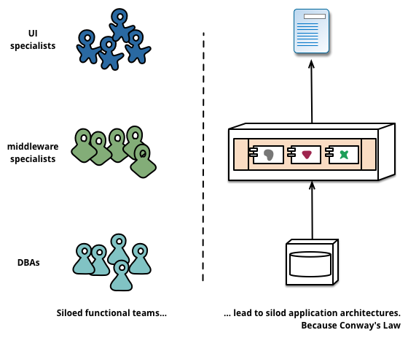
Team Organized by Technical Layer

Slide 26
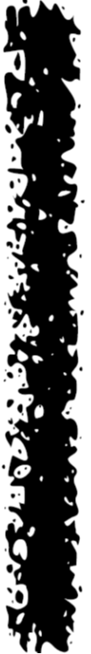
Traditional Organizational Structure
GAP & WALL

Slide 27
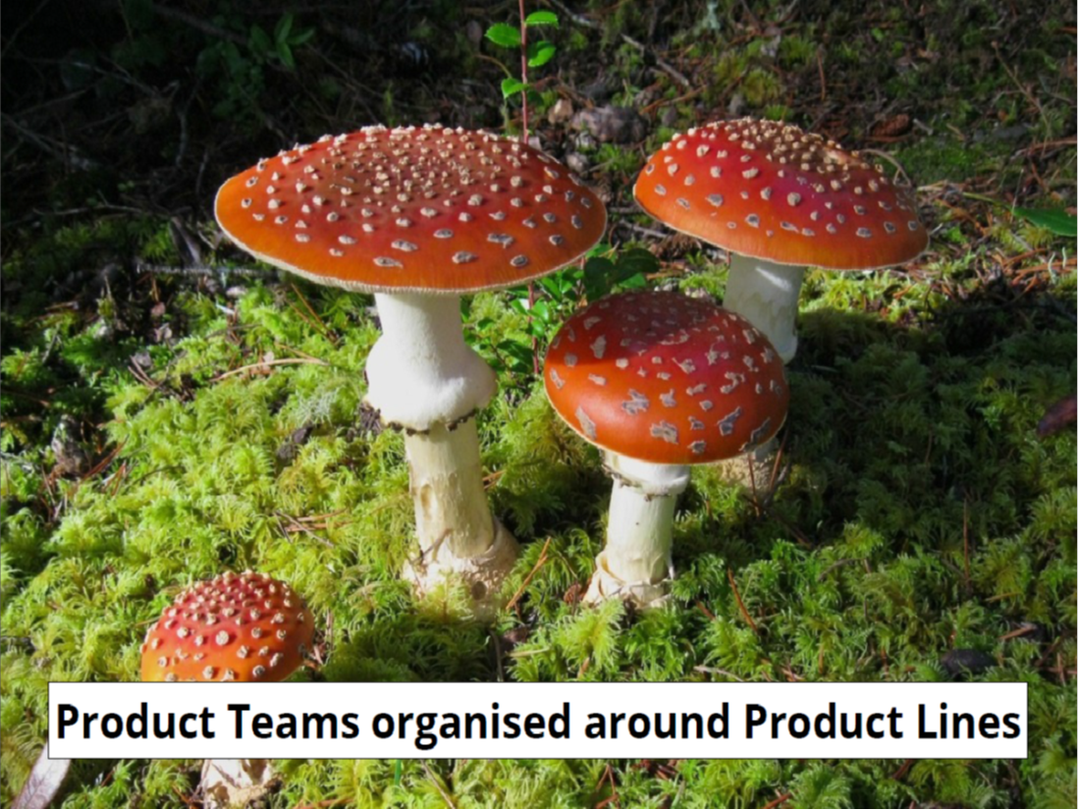
Microservices Organization
Organized around Business Capabilities
Products not Projects
Full stack skill team

Slide 28
The Cost of Microservices
System Complexity
Too much microservices, developer can’t build context and see the big picture,
Need better architectural integration patterns.
Performance
Performance penalty because of cross-process invocation, 20 - 200ms per hop average.
Tune time consuming invocation, leverage microservices invocation pattern.

Slide 29

View
Microservices Architecture - A Case In Practice
Controller
Common Concerns : routing, auth, rate limiting, monitoring, logging
Service Routing Table
Model

Slide 30
Take Away
Independently scalable, deployable, changeable, replaceable
Evolutionary architecture and emergent design are approaches that maximize flex
Programmable microservices platform fostering innovation
Standardize in the gaps between services – flexible about what happens inside the boxes
Separation of Concerns & Bounded Context
Another layer of indirection for decoupling

Slide 31


Slide 32
Reference
Micro-service architecture
http://yobriefca.se/blog/2013/04/28/micro-service-architecture/
Micro-service by Martin Fowler
http://martinfowler.com/articles/microservices.html
Migrating to microservices by former Netflix cloud architect Adrian Cockcroft.
http://qconlondon.com/dl/qcon-london-2014/slides/AdrianCockcroft_MigratingToMicroservices.pdf

